Slide 1
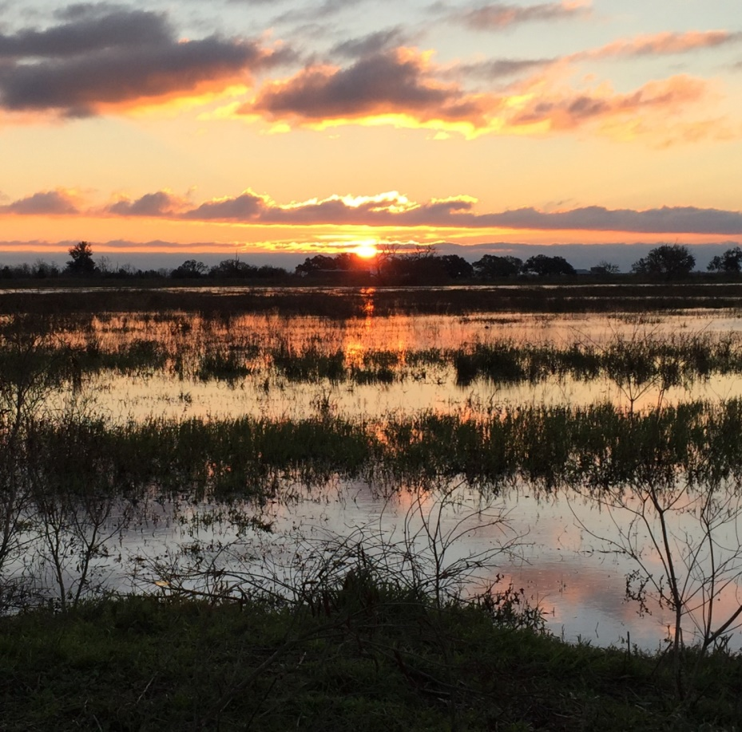
Exxon Valdez & Deepwater Horizon Restoration Parallels Houston Safari Club Foundation By HSCF Life Member Tim Richardson 4/20/21
Notes:
Thank you Joe, I’m proud to be a new HSCF Life Member and to be working closely with the Club on oil spill restoration. This presentation discusses ecosystem impacts of the nation’s two worst oil spills and restoration efforts in Alaska and Texas but mostly through the lens of government affairs in Washington, Juneau and Austin. HSCF was and still is involved in both spill restorations as an important conservation stakeholder.

Slide 2
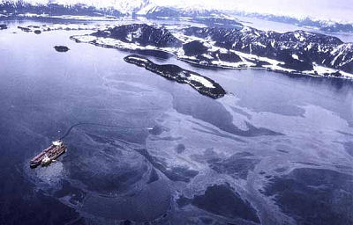
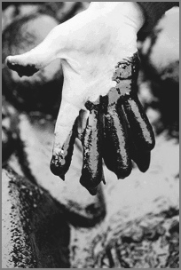
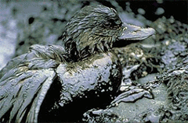
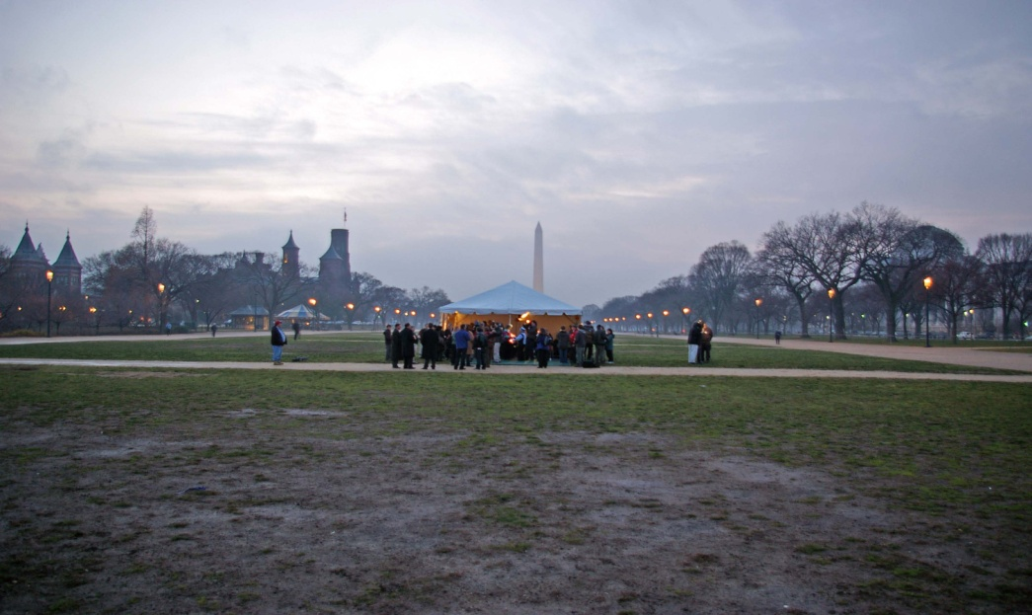
The Exxon Valdez oil spill shocked the nation and had two major damage categories: wildlife and people
Notes:
The Exxon Valdez tanker in the upper left ran aground on Bligh Reef in Prince William Sound and spilled 11 million gallons. 80% of the oil stayed in the tanker so the Coast Guard exercised extreme caution before moving the ship. A second empty tanker off-loaded the crippled Exxon Valdez. The nation’s media brought the wildlife destruction home into U.S. living rooms and global audiences. The people impacts in the spill region created economic chaos. Many made money in the clean-up but salmon prices and commercial fishing assets took a long term hit, some spillionaires were created, some actual damages were paid, the punitive damages took 19 years to resolve.

Slide 3
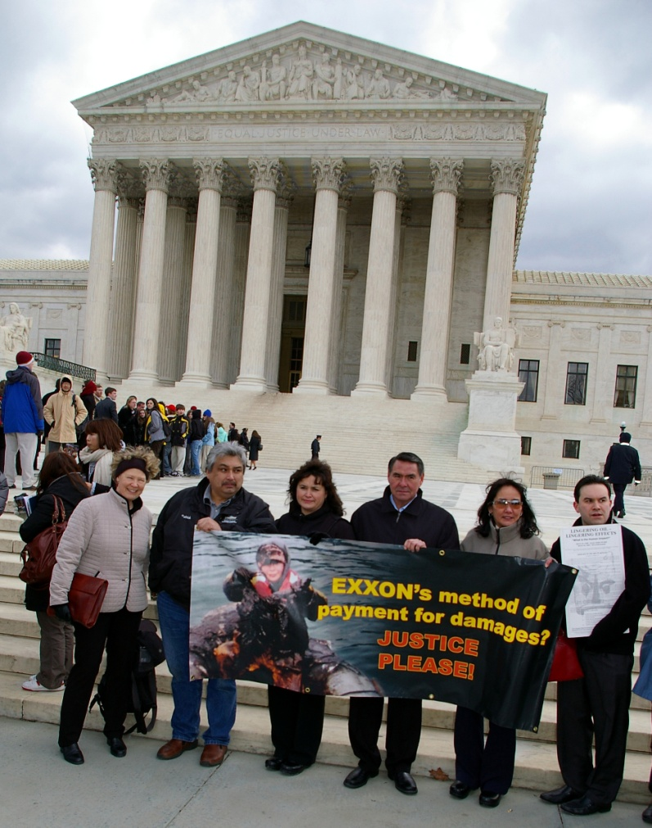
Five Elements of Oil Spill Response
Understanding the spill and a
proper response is a
Biological
2. Economic
Legal
Political
5. Public Relations
enterprise
Notes:
The first thing that happened was Alaska and federal natural resource agencies documented known wildlife and habitat damages. The State of Alaska estimated economic damages to its businesses, towns and boroughs, tourism,etc. These ecological body count and economic damages laid the basis for the many Exxon lawsuits. The uproarious political response occurred in Juneau and Washington. The whole country knew the Exxon Valdez penalty and restoration outcomes would become precedents for future spills. Public Relations/lobbying was at ramming speed under bright media lights.

Slide 4
Timeline: Exxon Valdez Spill to Ecological Settlement and start of Restoration
March 24, 1989, Exxon Valdez Oil Spill
Oil Spill Clean Up Summers of 1989, 1990, 1991
Exxon Consent Decree for $1 billion, October 1991 (30 months)
Creation of Exxon Valdez Oil Spill Trustee Council in 1991 made up of 3 state and 3 federal agencies: Alaska Department of Law, Alaska Department of Fish and Game, Alaska Department of Environmental Conservation, U.S. Department of Agriculture, U.S. Department of Commerce, U.S. Department of Interior.
Restoration Plan designed and adopted by the summer of 1993 (50 months) allocating EVOS natural resource settlement funds to two main categories:
A. Habitat Protection for the Replacement of Spill Impacted Equivalent Resources
B. Marine and other Wildlife Research and Monitoring
www.evostc.state.ak.us
Google: Exxon Valdez Trustee Council
Notes:
The Exxon Valdez restoration timeline shows that it took 30 months to reach the Alaska Department of Law and US Department of Justice Consent Decree with Exxon. The plan to spend the money took four years and two months

Slide 5
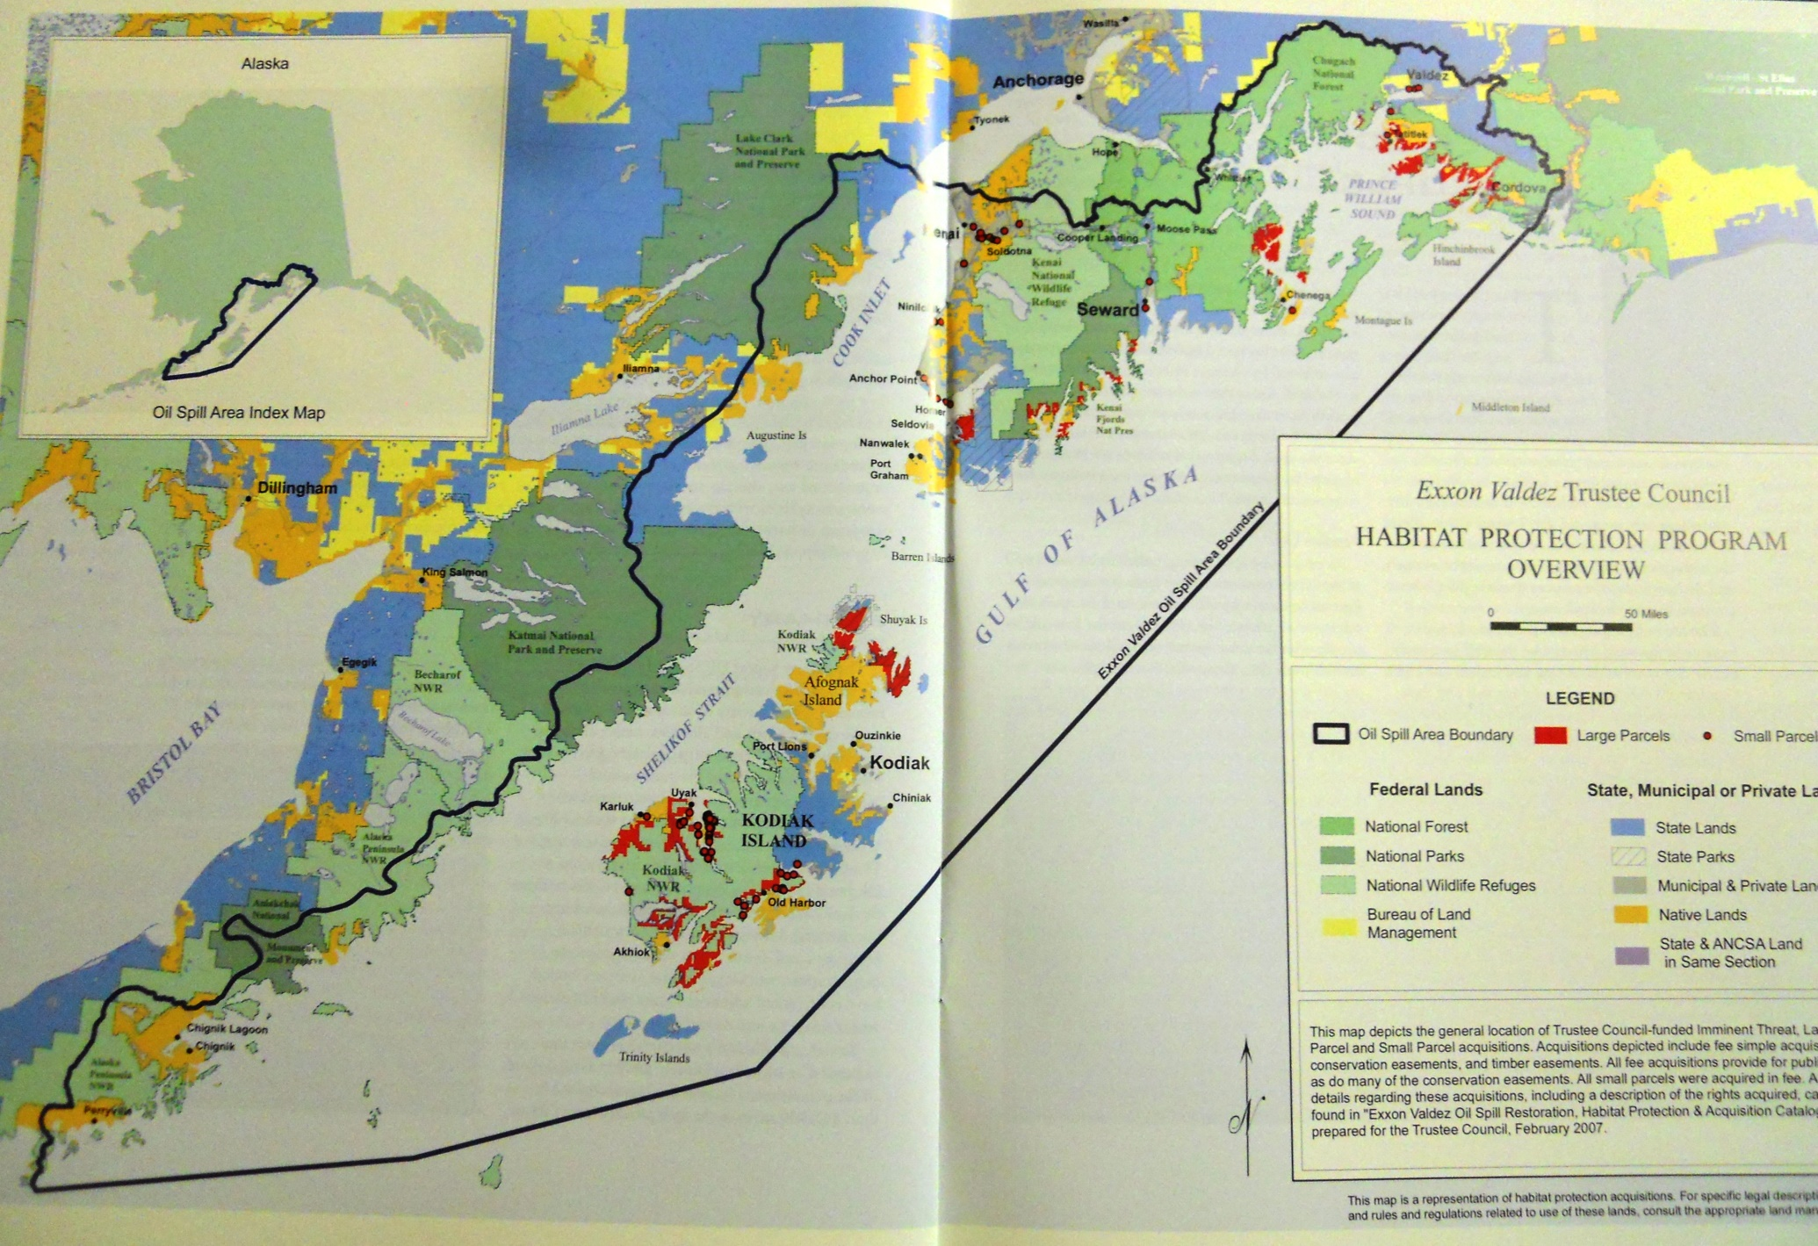
Notes:
The oil spill region was identified and that included 1,200 miles of Alaska coast and most of the areas impacted were federal conservation units including national forests, national parks and wildlife refuges. Native corporation private inholdings (in red) had many of the best salmon drainages (70% of Kodiak’s salmon runs were on private land) and forest areas. Anchorage is in the upper right of the map. Prince William Sound center right, Kenai Peninsula in the upper center, Kodiak Island lower center, Alaska Peninsula on the left side. The red areas equal more than 750,000 acres of coast targeted for permanent protection, to be purchased in fee or with permanent conservation easements.

Slide 6
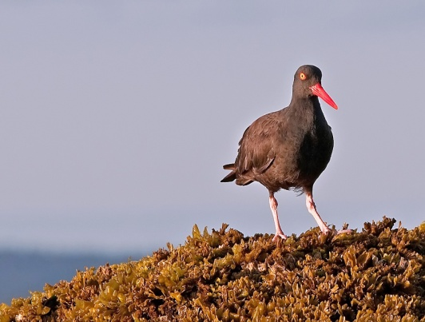
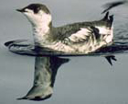
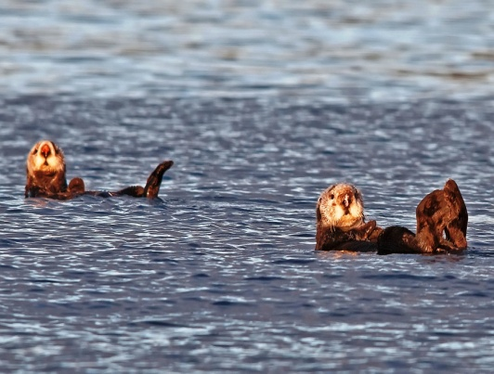
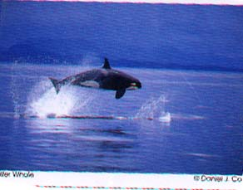
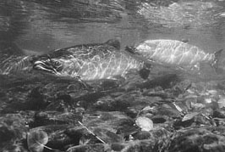
Natural Resources Damages Act, Clean Water Act & Migratory Bird Treaty Act + Alaska laws led to the $1 billion Exxon Settlement
A six member state & federal trustee council is guided by the mission of “replacement of equivalent resources injured by the spill.”
+/- $450 million was directed to habitat conservation
“Link to injury & potential for benefit”
became the restoration scorecard
Notes:
The Natural Resource Damages Act, Clean Water Act and Migratory Bird Treaty Act plus Alaska conservation laws led to the Exxon $1 billion ecological damages settlement. A Trustee Council was established as a stand alone federal agency with 3 state and 3 federal trustees making funding decisions on behalf of the Governor of Alaska and the President of the United States. Any funding requires a 6-0 votes which set up horse trading between state and federal trustees.

Slide 7
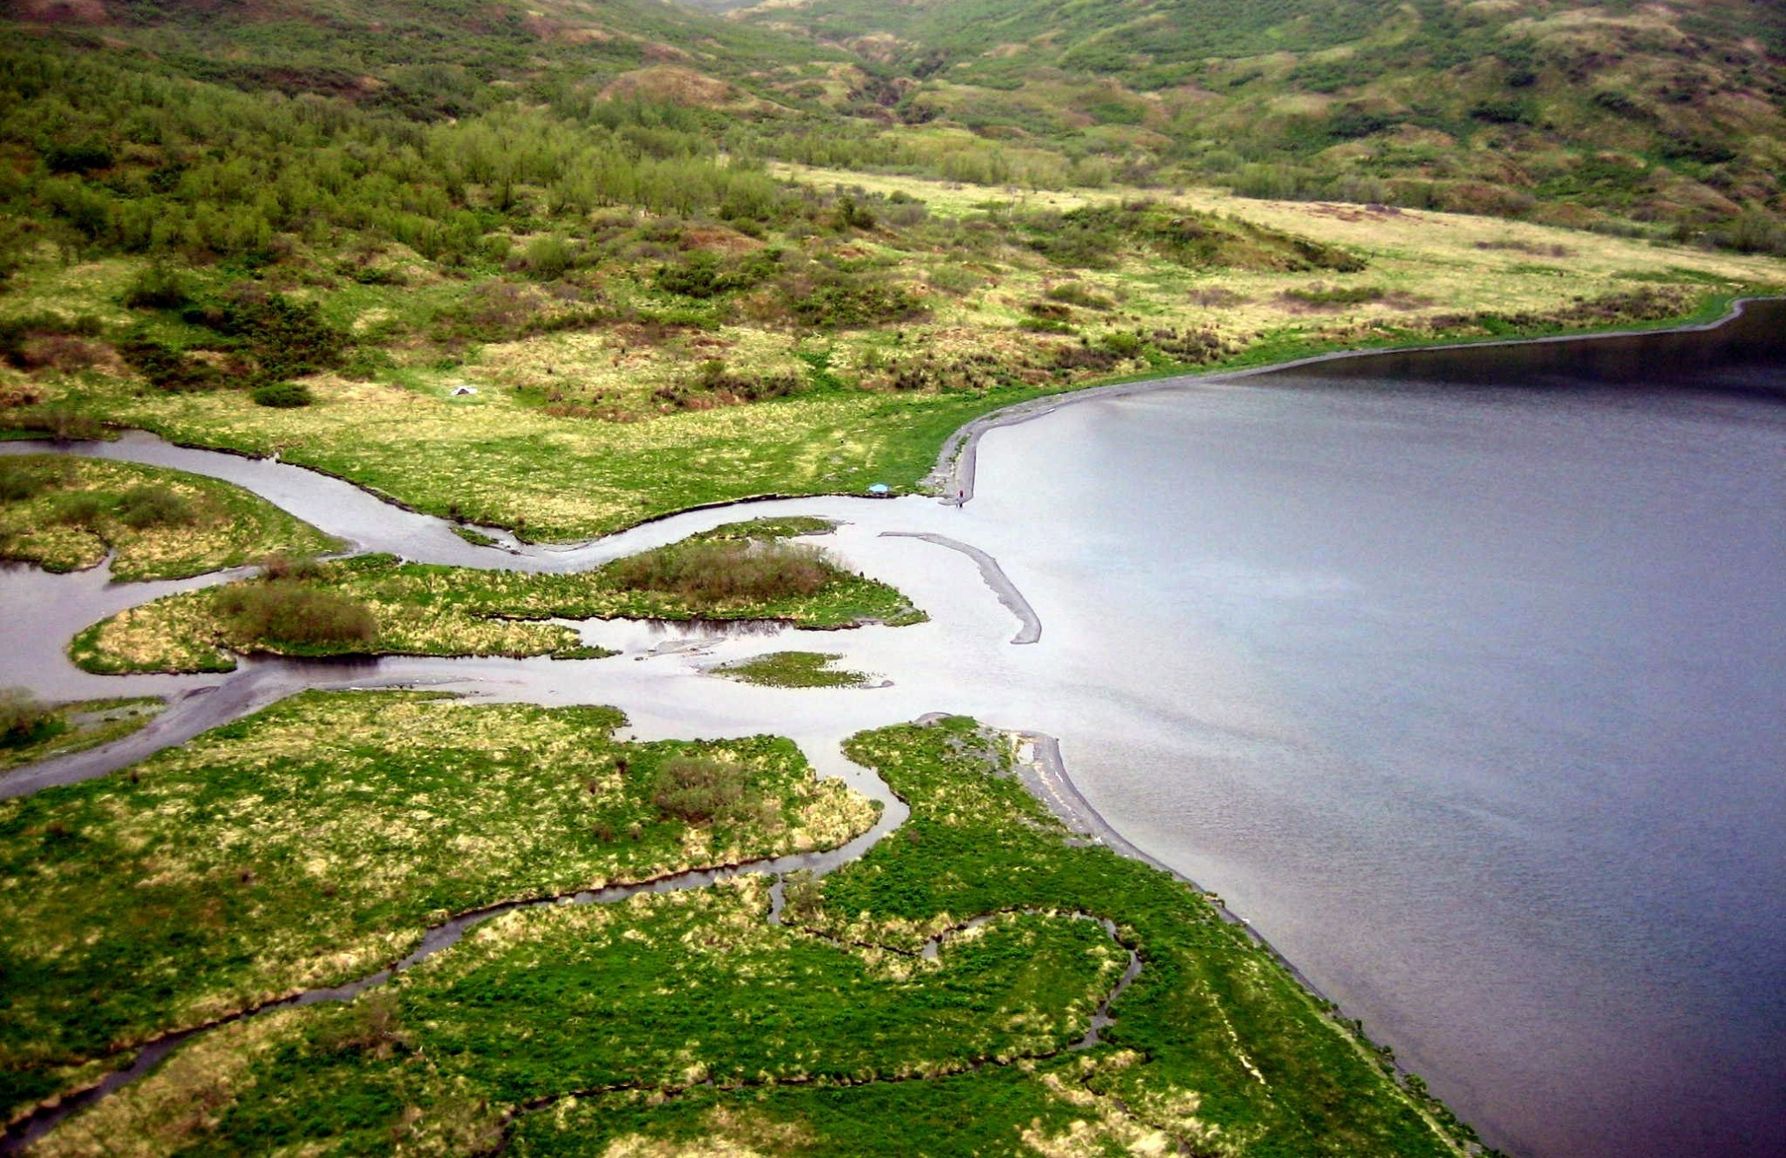
Oil spill mitigation = coastal conservation
Notes:
Most of the species and resources injured by the spill depended upon coastal habitats for nesting, breeding and feeding. It is difficult to spend funds on purely marine damages. An Orca whale’s food often comes from terrestrial habitats (salmon).

Slide 8
Public meetings are exhaustive but essential for habitat protection to succeed
Notes:
The public, especially grant funding applicants became involved in extensive rounds of meetings. The George W. Bush Administration officials are on the lower right. Native corporation landowners are on the left. I’m in the light shirt on the lower left. I set up the meeting for the landowners but was never a decision maker in the negotiations.

Slide 9
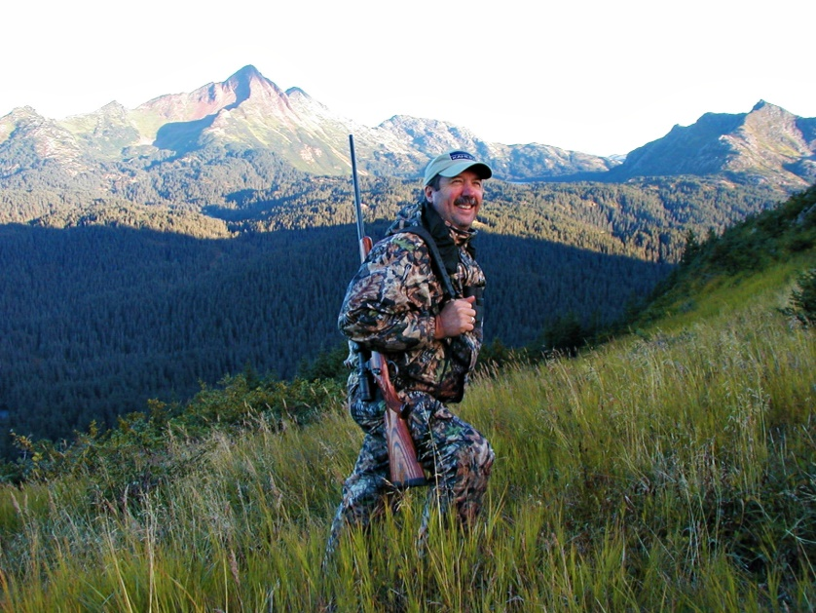
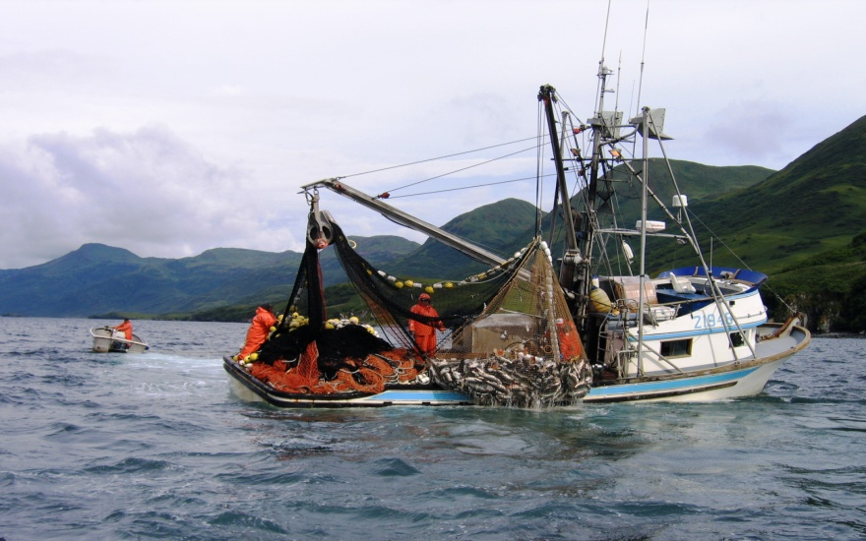
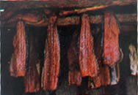
Stakeholders are key to Alaskan oil spill habitat conservation politics
Notes:
A major part of my job was to seek endorsements from stakeholder groups including sport hunters and anglers like HSC’s Tony Houseman. Commercial fishing interests, both boats and canneries, are the largest employers in the spill region and they wanted the salmon rivers protected in perpetuity. Ecotourism represented by the kayaker had a major voice via chambers of commerce and guides and lodges. The subsistence needs of rural residents round out the “Big Four” that benefit from habitat protection agreements.

Slide 10
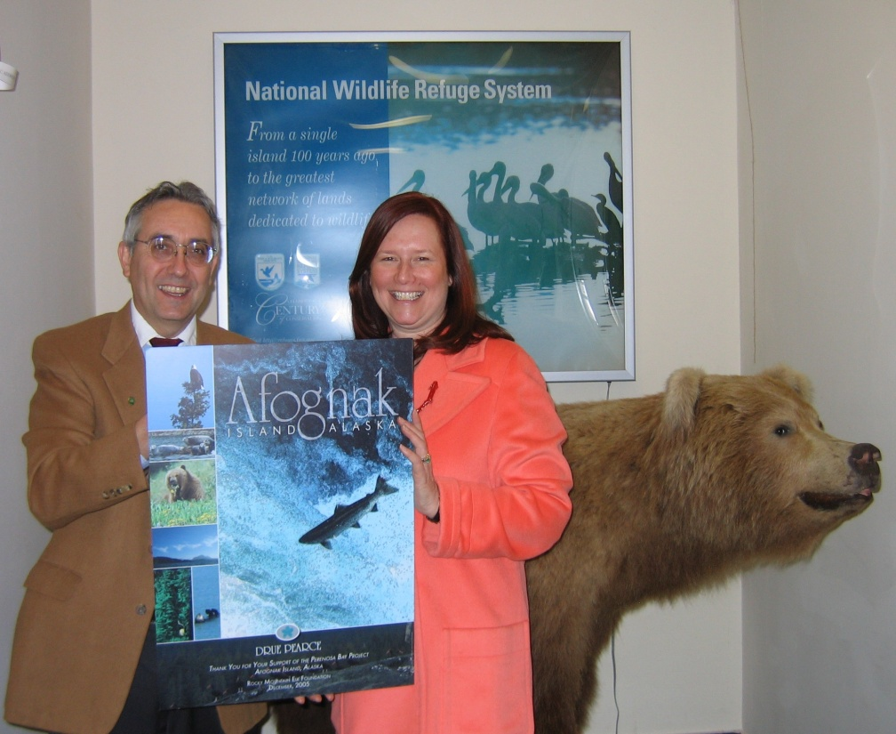
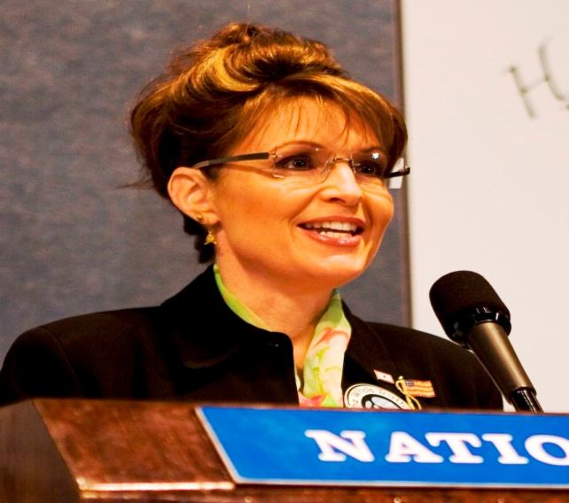
Exxon Valdez habitat conservation earned bi-partisan support
Notes:
The laws used to create the settlement have a long bi-partisan history including NRDA and Clean Water Act passed by a Democratic Congress and signed by Richard Nixon in the 1970s On the left is me with a Geo. W Bush Dept. of Interior official, the Upper right is Alaska Gov Walter Hickel, and the center is then Alaska Governor Sarah Palin. All of them did something positive and there is still over $100 million in the Exxon Valdez account.

Slide 11
4 Exxon Valdez lessons for Oil Spill Restoration * Oil spill mitigations are major coastal conservation opportunities * There is an invisible ‘game clock.’ Timelines matter to both connect with aroused public awareness and set long term priorities. * ‘Link to injury’ and ‘potential for benefit’ should guide wildlife conservation decisions * Stakeholder buy-in and public relations can be half the battle
Notes:
4 key takeaways. Oil spill mitigation can present major, historic, coastal conservation opportunities. Timelines matter so that political pressure from an aroused public is strong. Grantees compete to show benefit to species and habitats with a link to injury. Conservationists should rally stakeholders. HSCF is an active sportsmen’s conservationist leader. The most recent example is a successful expansion of the spill boundary to include the Copper River Delta.

Slide 12
Now comes BP Deepwater Horizon
Notes:
Eleven years ago today, Transocean’s Deepwater Horizon floating oil rig exploded over BP’s Macondo well killing 11 men and injuring 17 workers. I strongly recommend watching the film Deepwater Horizon which is an engineering ‘who done it’ for the first half of the movie with Mark Walberg, John Malkovich and Kurt Russell in major roles. The film is not an oil industry bashing Hollywood film.

Slide 13
5 differences between BP spill and Exxon Valdez * The BP spill was 19 times larger than Exxon Valdez @ 4.5 million barrels * The wildlife impacts are less graphic and require long term assessment * There are more state governments involved, 5 instead of 1 * There is less federal and more private land than in the Alaskan spill zone. * The BP economic people damages are handled, while wildlife restoration is at “half time” in Texas eleven years after the spill.
Notes:
5 differences, BP spill was 19 times larger than EVOS at 4.5 million barrels. Wildlife impacts were less graphic and require long term assessment. There are 5 state governments instead of 1. There is less federal land and more private land than in Alaska. The people damages are handled and wildlife restoration is at half time and Alaska restoration is at the end of the 4th quarter.

Slide 14
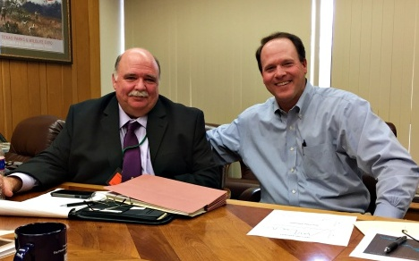
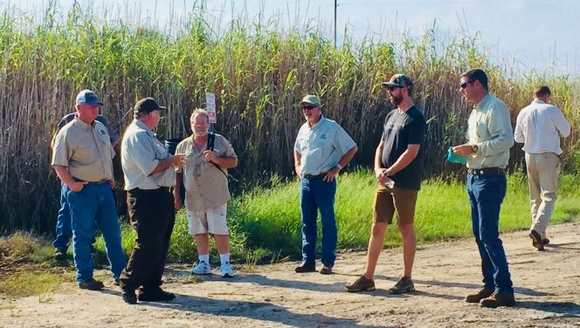
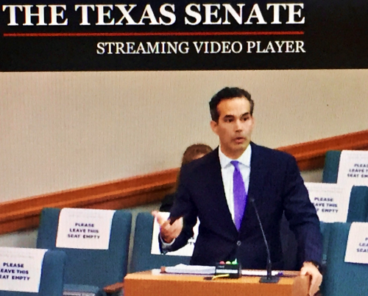
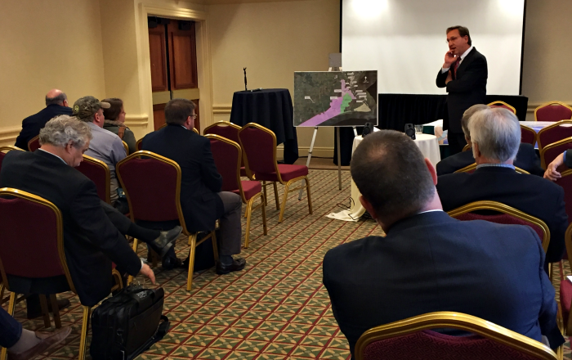
Texas natural resource agencies could be the nation’s best
Notes:
Texas has top notch natural resource agencies including Texas Parks and Wildlife Department (Carter Smith upper left), Texas General Land Office (Commissioner George P Bush lower left) and Texas Commission for Environmental Quality led by Toby Baker. HSCF board member J.D. Burrows join sportsmen’s summit in 2019. Local leaders such as Jefferson County Judge Jeff Branick at lower right interacts with natural resource leaders at a wildlife conference. HSCF Board Member Ross Melinchuk seated lower left with briefcase.

Slide 15
Deepwater Horizon sources fund $50 million per year. The new Texas General Land Office GOMESA account funds $50 million per year. Hurricane recovery often funds coastal resilience. A new federal infrastructure bill would include coastal Texas.
Notes:
Funding streams are complex but five main DWH funds produce $50 million per year. The TxGLO GOMESA program produces over $50 million per years in state funds plus another 20% divided by 18 coastal counties. Hurricane disaster response funds can also fund coastal restoration and a new federal infrastructure could bring major funding to the Texas coast to address storm surge and flooding.

Slide 16
What is the best way to help restore the Gulf of Mexico ecosystem?
Prevent Future Spills
Let ‘Mother Nature’ rebound. The Bureau of Ocean Energy Management (BOEM) needs to do its job. Texas has invested in new drilling and operating guidelines.
2. Conserve existing nesting, breeding and feeding habitats to create permanent coastal ‘nature banks’ assuring resilience against future spills. Species can repopulate.
3. Improve Water Quality reaching the Gulf
The RESTORE Act allows funds to be allocated to best improve water reaching the Gulf. Urban and agricultural impacts must be addressed.
Notes:
What’s best way to help restore the Gulf? 1 prevent future spills, 2 conserve coastal habitat. 3. improve water quality reaching the Gulf from land reducing existing negative impacts.

Slide 17
Coastal wetlands should be the highest restoration priority to keep ecosystems resilient because they are nurseries for over 90% of the wildlife species in the Gulf of Mexico and critical migratory bird areas
Notes:
Coastal wetlands and marshes are obvious conservation targets because they are nurseries for over 90% of fish and wildlife in the Gulf and critical for migratory birds from waterfowl to neo-tropicals.

Slide 18
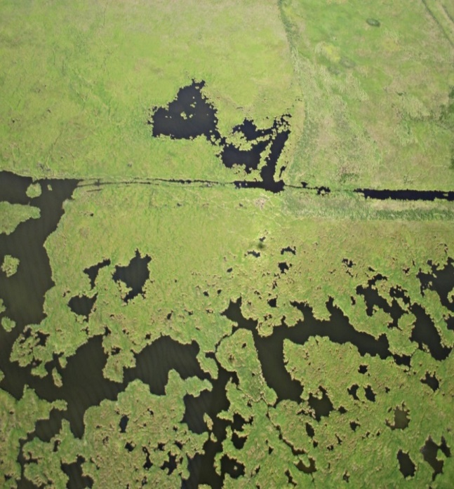
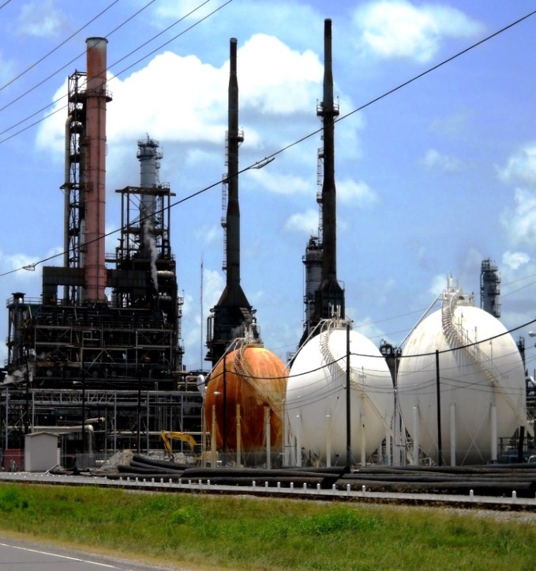
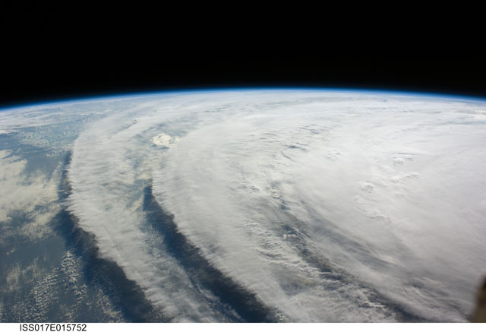
Earth Wind & Fire A Texas example of Coastal Restoration in the Chenier Plain
Notes:
The largest project area to date involves the Texas Chenier Plain on the Upper Texas coast

Slide 19
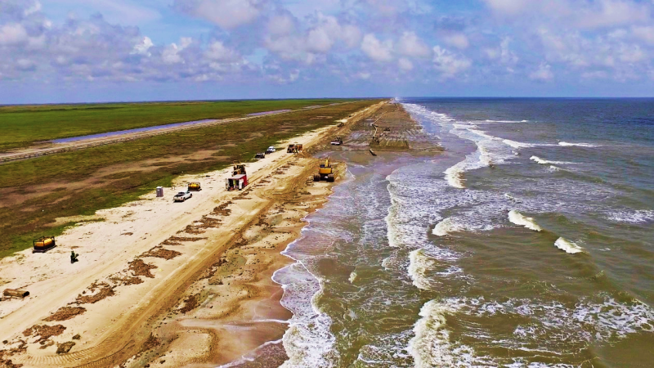
Beach nourishment underway for 20 miles of Jefferson County coast
Notes:
This Chenier Plain project should be in the news this year as the Texas GLO works with federal partners to renourish 20 miles of Jefferson County’s coast. The goal of rebuilding the beach and dune system badly damaged by Hurricane Ike is to keep saltwater out of Texas’ largest coastal marsh so that vegetation survives holding the rich Chenier Plain soils intact and not washed away into the Gulf.

Slide 20
EARTH: The Chenier Plain is a 6.5 million-acre coastal region in Southwest Louisiana and Southeast Texas providing “multi-state landscape scale” restoration opportunities. Chenier Plain soils are “deltaic” from ancient times when sea levels were much higher and the Mississippi’s outlet was near present day Baton Rouge. Gulf currents flowed westerly blanketing today’s Chenier Plain with soil deposition that supports extraordinary biodiversity. 2015 was the International Year of Soil. Chenier soils are biologically rich but vulnerable to salt water intrusion. FAST FACT: There are more micro-organisms in a tea spoon of soil than there are people on Earth. Deepwater Horizon restoration can preserve the Chenier Plain.
Notes:
The Chenier Plain is a 6.5 million acre coastal region with 2/3rds in Louisiana and 1/3rd in Texas. Deltaic soils from ancient Miss River deposits create a highly rich ecosystem for insects, birds, finfish, shellfish, and alligators. A ridge and swale topography dominates this region with oak trees (Fr: “cheniers”) on the ridges and freshwater wetlands in the swales.

Slide 21
Wind: Powerful hurricanes and tropical storms frequent the Chenier Plain coast bringing salt water intrusion that destroys fresh and brackish water-dependent vegetation needed to prevent deltaic soils from washing out to the Gulf when plant roots die and release the soils. Hurricane Ike caused $30 billion in property and infrastructure damages with a huge portion of damage in the Texas Chenier Plain.
Notes:
Hurricanes have become stronger and more numerous as the water in the Gulf of Mexico warms.

Slide 22
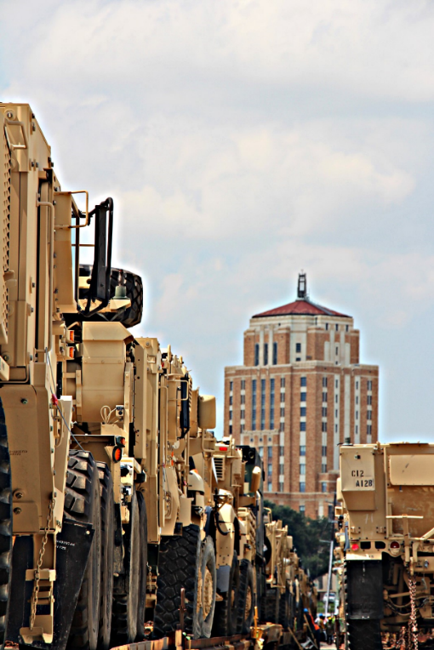
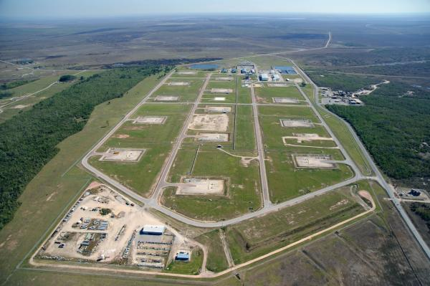
Fire in the Chenier Plain signifies nationally important energy and national defense assets including the nation’s largest refinery complexes, over half the nation’s Strategic Petroleum Reserve, the #1 military port in the U.S., and 75% of the military aviation jet fuel all protected by the Gulf of Mexico’s largest intact coastal marsh.
Notes:
The Texas Chenier Plain region is home to nationally significant energy and national defense assets including the nation’s largest refinery, over half the Strategic Petroleum Reserve, the #1 US military port and 75% of the military’s aviation jet fuel.

Slide 23
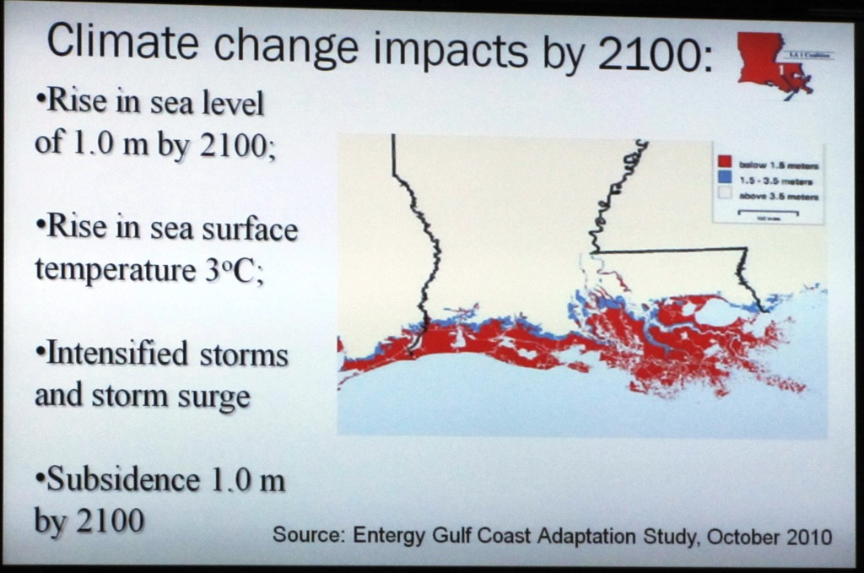
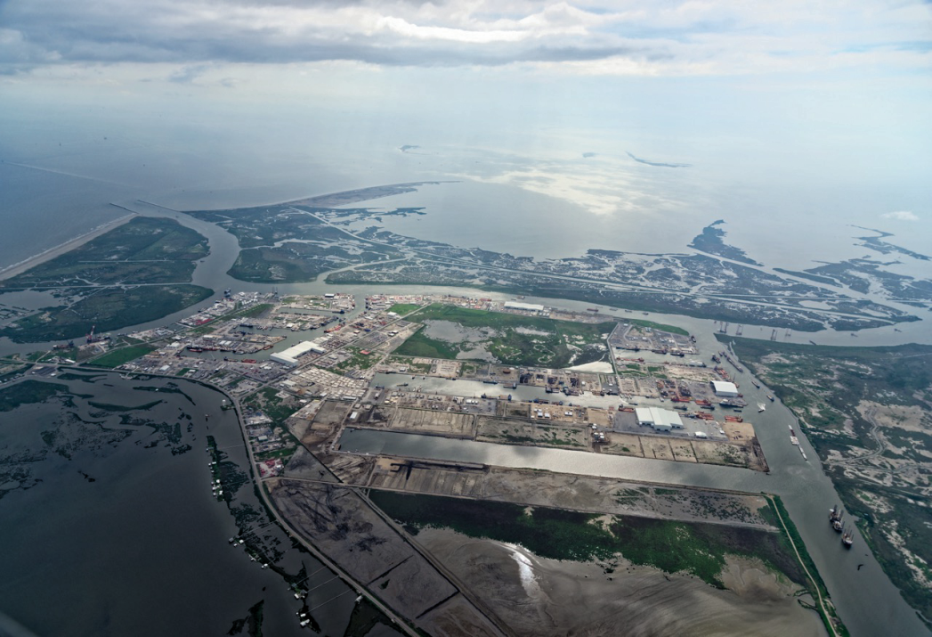
Private sector leaders recognize that sea level rise, hurricanes and land subsidence threaten asset viability. Entergy’s map shows Louisiana’s land loss crisis extends into Southeast Texas. Port Fourchon, LA below
Notes:
Sea level rise, subsidence and hurricanes are relentlessly destroying coastal areas. The map on the left is Entergy’s projection of threats to coastal areas in Louisiana and the Upper Texas coast from 1 meter sea level rise, 1 meter subsidence and sea surface temperature rise of 3 degrees Celsius. The red areas are in big trouble and could all be underwater by 2100, in 79 years, or one lifetime from now.

Slide 24
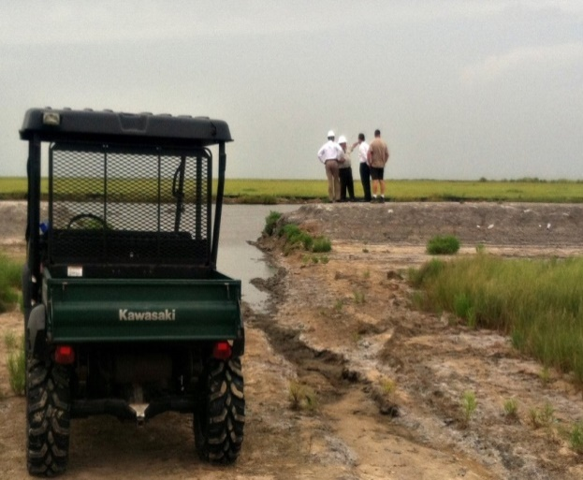
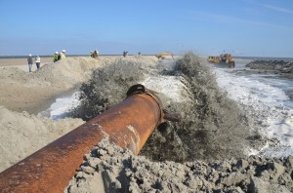
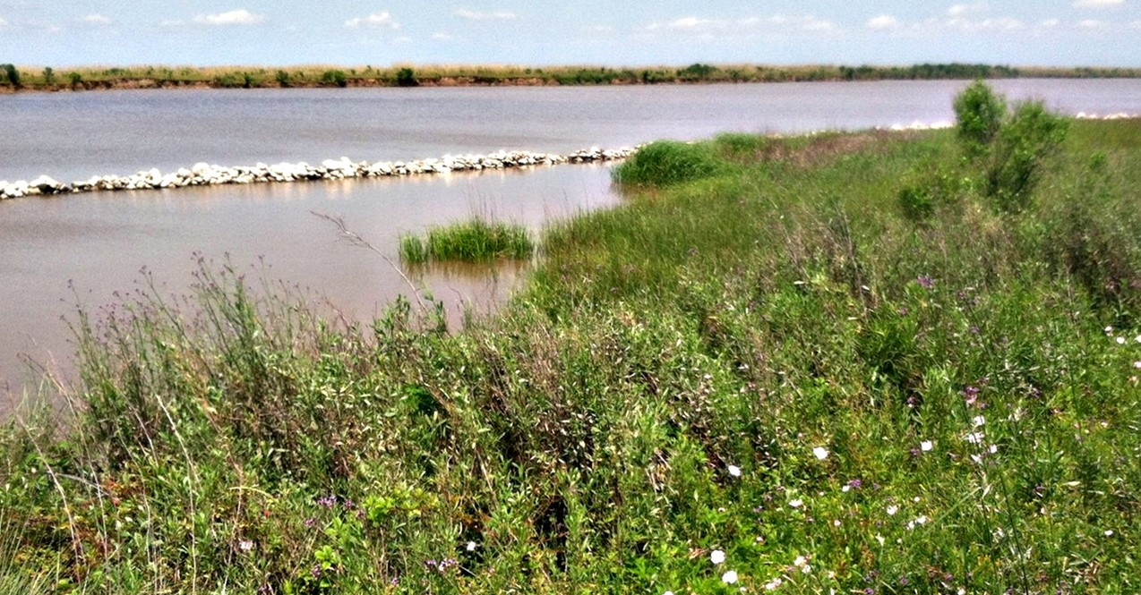
Proven strategies such as beach nourishment in Cameron Parish, the clay berm construction in Jefferson county and Ducks Unlimited’s breakwater armoring of the GIWW are critically needed to conserve the Chenier Plain.
Notes:
The BP DWH funds are being deployed to keep the Texas Chenier Plain intact including 20 miles of rebuilt beach, a 4 foot high clay berm and breakwaters to line the GIWW along its most valuable stretch from East Galveston Bay to the Louisiana state line.

Slide 25
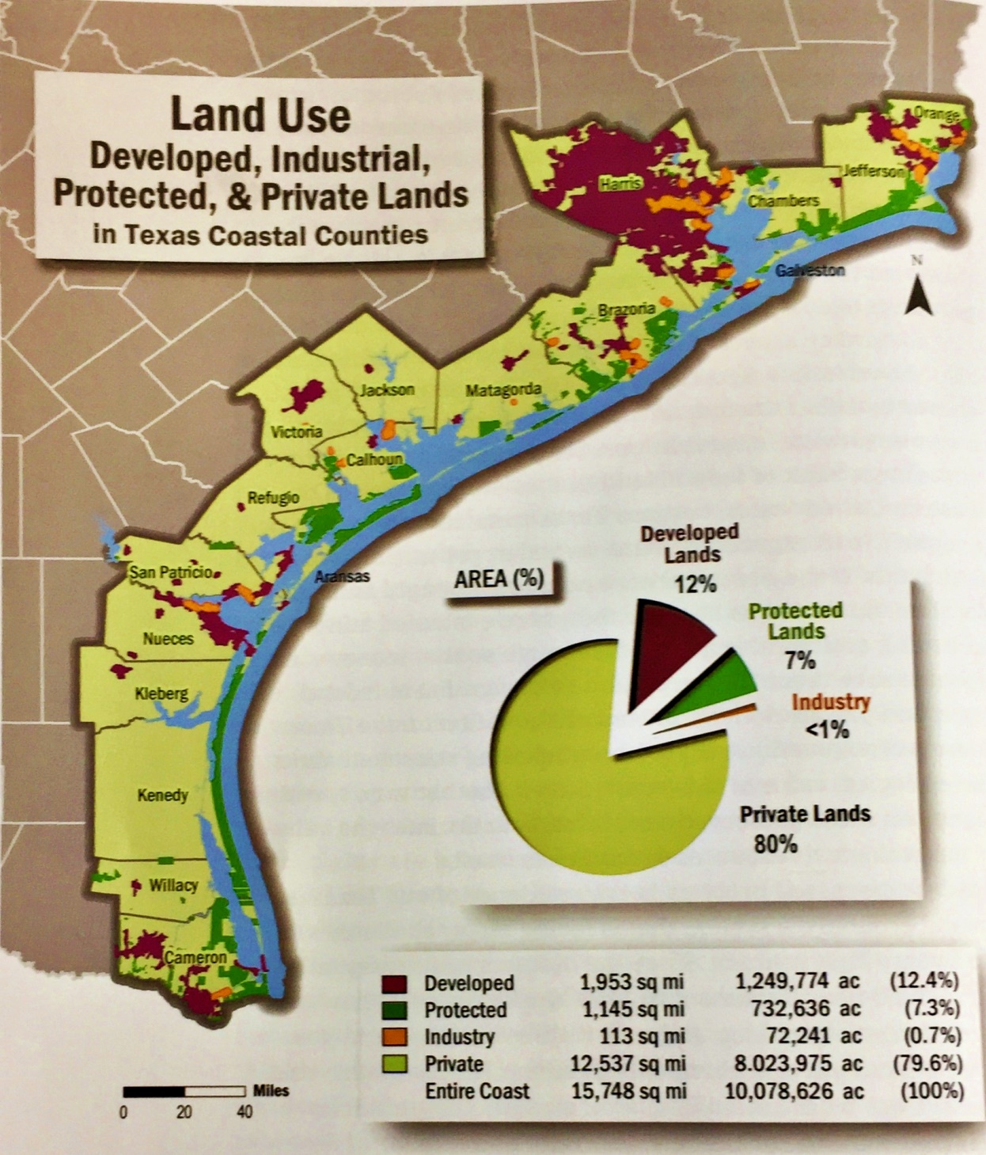
Notes:
The Texas coast should be viewed as a highly threatened national treasure. This map shows a combination private land in yellow, developed human population areas in purple and bright green state and federal protected lands in green which are mostly right along the coast. Map Source, Jim Blackburn, A Texan Plan for the Texas Coast

